Slide 1
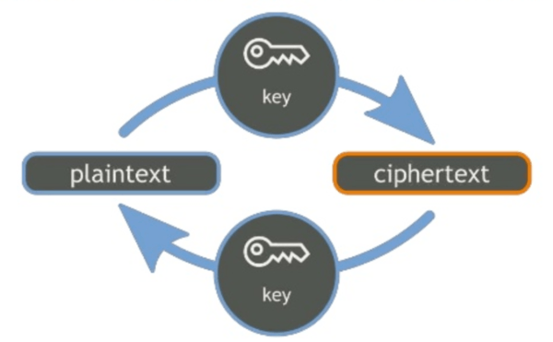
Encryption

Slide 2
Encryption vs cryptography
Earlier, we covered basic cryptography. Now, we look to the practical application of cryptography.
Encryption is using cryptographic tools to protect data. Converting plaintext data into ciphertext encrypted blobs.
You likely already use encryption personally, so we will look at enterprise implementations.

Slide 3
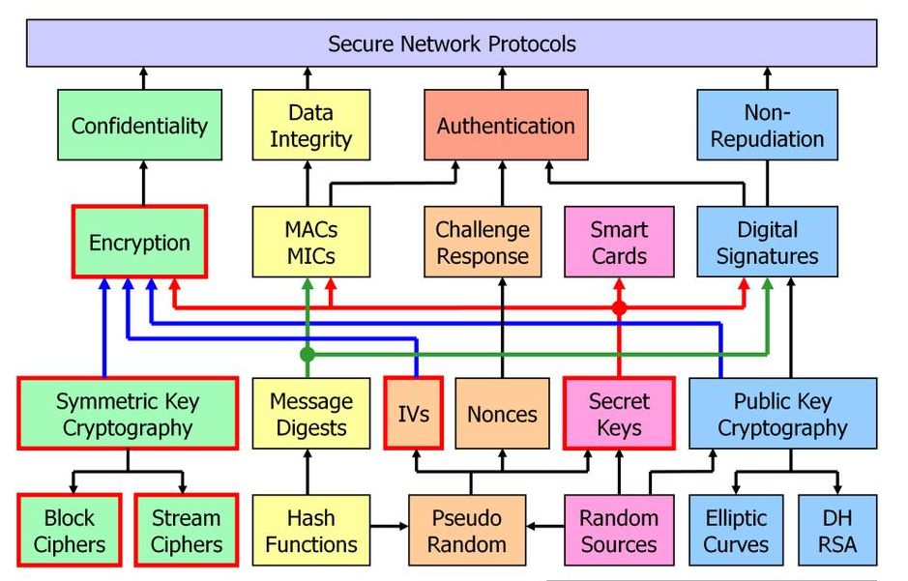

Slide 4
Enterprise Encryption
Where might you find symmetric key cryptography?
Partial/Full Disk Encryption, encrypted archives, etc.
Where might you find asymmetric key cryptography?
Communication, TLS, digital signatures, etc.

Slide 5
Symmetric Cryptography
Both parties share the same key (kept secret)
Before communications begin, both parties must exchange the shared secret key
Faster than asymmetric cryptography
Best suited for bulk encryption
N(N-1)/2 = number of keys needed
a.k.a. Secret, Single, Conventional, Session, Shared, Private, File Encryption Key (FEK)
Notes:
symmetric key An algorithm that relies on a “shared secret” encryption key that is distributed
to all members who participate in communications. This key is used by all parties
to both encrypt and decrypt messages. Sybex 8th ed.
Symmetric - Normal key lengths: 40, 56, 128, 192, 256
Number of Keys Needed Example:
100 people: 100(100-1)/2 = 4950 keys
Sources:
(ISC)2 CBK 2008 (pgs. 236-252)
Shon Harris CISSP All-in-One Exam Guide 4th Edition (pgs. 679-681)

Slide 6
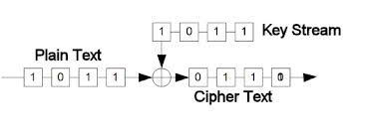
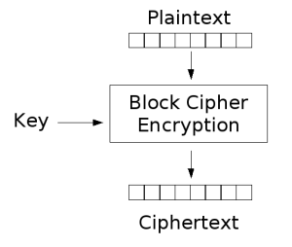
Symmetric Algorithms
Two types of symmetric algorithms:
Stream Cipher / Stream Algorithm
Works on one bit (or byte) at a time
Block Cipher / Block Algorithm
Works on blocks of bits
Notes:
Stream Cipher:
Data is sequentially encrypted bit-by-bit (or byte-by-byte)
Plaintext mixed with a key stream controlled by a key
Usually implemented in hardware
Requires no memory
Data is encrypted on-the-fly
A very fast mathematical operation
RC4 used in WEP, A5 used in GSM cellular, PKZIP, Rabbit, SOBER, W7
Synchronous stream ciphers
Require that key generators on the two ends be kept synchronized by external means
Loss of a single bit causes the loss of all data that follows it
Not good for wireless medium where loss is widespread
WEP corrects this by encrypting each packet with a unique key (IV concatenated with the mater key)
IV portion transmitted in the clear
Key space is low
Key reuse is high
Weak keys is likely
Rules for Implementation and Operation of Stream-Based Ciphers:
Keystream should not be linearly related to the cryptovariable
Knowing the output doesn’t disclose cryptovariable
Statistically unpredictable
Statistically unbiased
Should be as many 0s as 1s
Long periods without repetition
Functional complexity
Each keystream bit should depend on most or all of the cryptovariable bits
Block Cipher:
Depicts the method used by Cipher feedback, Output feedback, and counter
It involves the XOR process to operate in a streaming capacity
Usually implemented in software
Requires memory
Transforms fixed-length blocks of plaintext into ciphertext of the same length
Data is encrypted block-by-block (64, 128, 192, 256, etc.)
Uses substitution and transposition ciphers
Stronger than stream-based ciphers
Slower and resource intensive
Feistal principle: a round treats the input block as two halves, left half used to modify right and right half to modify left. This way the same circuit can be reversed.
Sources:
(ISC)2 CBK 2008 (pgs. 227-228)
(ISC)2 CBK 2008 (pgs. 229)
Shon Harris CISSP All-in-One Exam Guide 4th Edition (pgs. 685-687)
Shon Harris CISSP All-in-One Exam Guide 4th Edition (pgs. 687-688)

Slide 7
Stream Cipher XOR Operation
Treats message as a stream of bits
Performs mathematical XOR function on each individual bit
Uses keystream generators, producing a stream of bits that is XORed with plaintext bits to generate ciphertext
Converted Plaintext
Keystream
Output of XOR (Ciphertext)
Keystream
Reverted Ciphertext
0101 0001
0111 0011
0010 0010
0111 0011
0101 0001
Notes:
Input Plaintext is converted to bits.
Encryption process uses a binary mathematical function called exclusive-OR (XOR). XOR is applied to two bits (converted plaintext and XOR bits).
When combining the bits:
If the values are the same, the result is 0.
If the values are different, the result is 1.
Input Plaintext is converted to bits.
XOR truth table
X Y XorY
0 0 0
0 1 1
0 1
1 1 0
AND (1+1=1, 0+1=0, 1+0=0, 0+0=0
OR (1+1=1, 1+0=1, 0+1=1, 0+0=0)

Slide 8

Symmetric Key Encryption
Plaintext
Ciphertext
Symmetric Keys
Identical
Shared
Vulnerable
Plaintext
Ciphertext

Slide 9
Symmetric Algorithms
Cast 128 / 256 (64 bit/128 bit) – Some versions of GPG/PGP
DES 64 bit Block / 56 bit key (8 bit parity) – No longer used.
3DES 2-112 bit / 3-168 bit (48 Rds) – No longer used (Deprecated for all applications by 2023.)
Blowfish 64 bit – No longer used (short key size)
2fish 128 bit, 3fish 256, 512, 1024 bit – Not very common, but available.
RC 4 (Stream and WEP) 5,6 (Block) – 4 is deprecated, 5 and 6 only if sufficient block size is chosen.
AES 128 bit Block (128/10)(192/12)(256/14) – Most widely used today.
IDEA 64 bit Block / 128 key – Still available in OpenPGP as an option.
Safer+, Safer++ - Bluetooth uses custom versions for key derivation, but not encryption.
Notes:
Others:
BLOCK (ARIA, Camelia, Clefia, CMAC, Gost, MARS, Misty1, Seed, Skipjack, RC2, Serpent)
STREAM (W7, Sober, Rabbit)
Sources:
(ISC)2 CBK 2008 (pgs. 237-252)
Shon Harris CISSP All-in-One Exam Guide 4th Edition (pgs. 695-705)

Slide 10
Symmetric Algorithms
Cast 128 / 256 (64 bit/128 bit) – Some versions of GPG/PGP
DES 64 bit Block / 56 bit key (8 bit parity) – No longer used.
3DES 2-112 bit / 3-168 bit (48 Rds) – No longer used (Deprecated for all applications by 2023.)
Blowfish 64 bit – No longer used (short key size)
2fish 128 bit, 3fish 256, 512, 1024 bit – Not very common, but available.
RC 4 (Stream and WEP) 5,6 (Block) – 4 is deprecated, 5 and 6 only if sufficient block size is chosen.
AES 128 bit Block (128/10)(192/12)(256/14) – Most widely used today.
IDEA 64 bit Block / 128 key – Still available in OpenPGP as an option.
Safer+, Safer++ - Bluetooth uses custom versions for key derivation, but not encryption.
Notes:
Others:
BLOCK (ARIA, Camelia, Clefia, CMAC, Gost, MARS, Misty1, Seed, Skipjack, RC2, Serpent)
STREAM (W7, Sober, Rabbit)
Sources:
(ISC)2 CBK 2008 (pgs. 237-252)
Shon Harris CISSP All-in-One Exam Guide 4th Edition (pgs. 695-705)

Slide 11

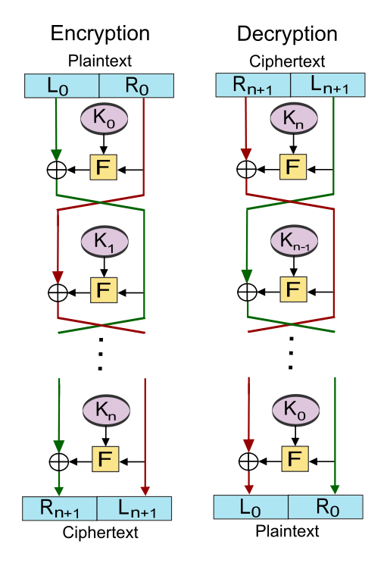
Feistel Ciphers
Cast 128 / 256 (64 bit/128 bit)
DES 64 bit Block / 56 bit key (8 bit parity)
3DES 2-112 bit / 3-168 bit (48 Rds)
Blowfish 64 bit
2fish 128 bit
RC 4 (Stream and WEP) 5,6 (Block)
AES 128 bit Block (128/10)(192/12)(256/14)
IDEA 64 bit Block / 128 key
Safer+, Safer++
Notes:
Others:
BLOCK (ARIA, Camelia, Clefia, CMAC, Gost, MARS, Misty1, Seed, Skipjack, RC2, Serpent)
STREAM (W7, Sober, Rabbit)
Sources:
(ISC)2 CBK 2008 (pgs. 237-252)
Shon Harris CISSP All-in-One Exam Guide 4th Edition (pgs. 695-705)

Slide 12
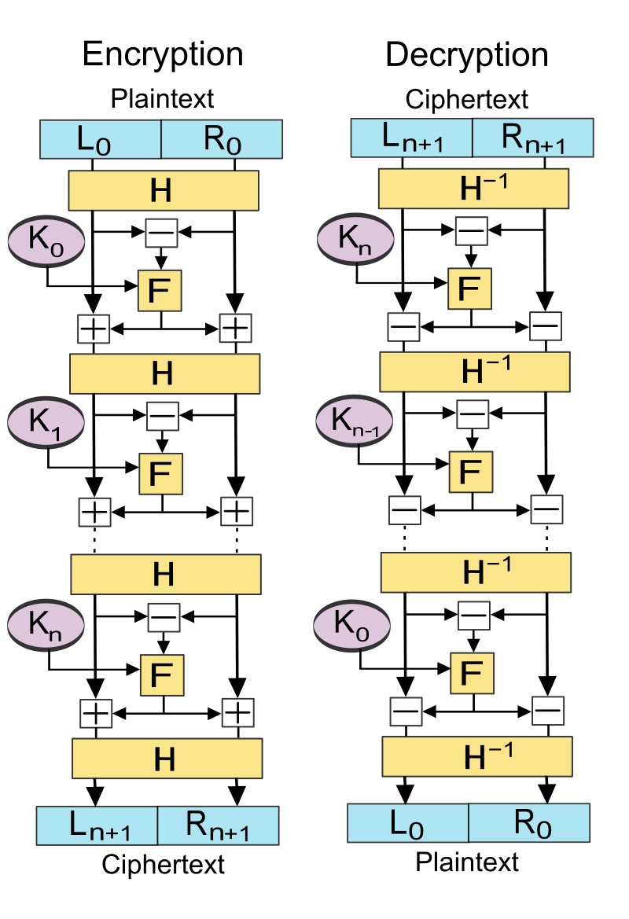
Lai-Massey Ciphers
Cast 128 / 256 (64 bit/128 bit)
DES 64 bit Block / 56 bit key (8 bit parity)
3DES 2-112 bit / 3-168 bit (48 Rds)
Blowfish 64 bit
2fish 128 bit
RC 4 (Stream and WEP) 5,6 (Block)
AES 128 bit Block (128/10)(192/12)(256/14)
IDEA 64 bit Block / 128 key
Safer+, Safer++
Notes:
Others:
BLOCK (ARIA, Camelia, Clefia, CMAC, Gost, MARS, Misty1, Seed, Skipjack, RC2, Serpent)
STREAM (W7, Sober, Rabbit)
Sources:
(ISC)2 CBK 2008 (pgs. 237-252)
Shon Harris CISSP All-in-One Exam Guide 4th Edition (pgs. 695-705)

Slide 13
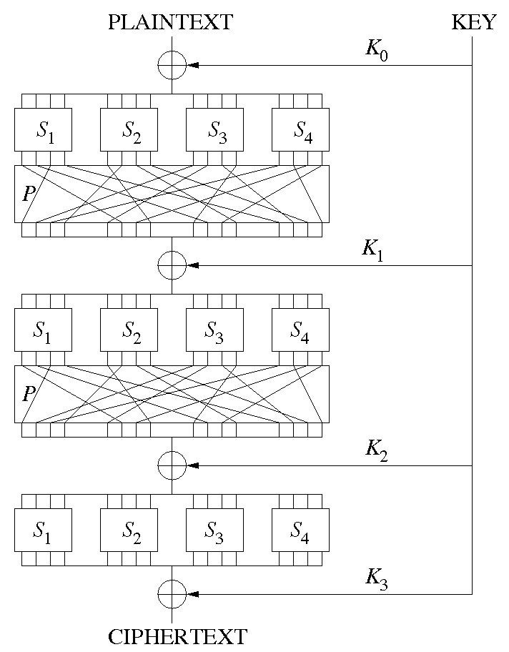
Substitution-Permutation Ciphers
Cast 128 / 256 (64 bit/128 bit)
DES 64 bit Block / 56 bit key (8 bit parity)
3DES 2-112 bit / 3-168 bit (48 Rds)
Blowfish 64 bit
2fish 128 bit
RC 4 (Stream and WEP) 5,6 (Block)
AES 128 bit Block (128/10)(192/12)(256/14)
IDEA 64 bit Block / 128 key
Safer+, Safer++
Notes:
Others:
BLOCK (ARIA, Camelia, Clefia, CMAC, Gost, MARS, Misty1, Seed, Skipjack, RC2, Serpent)
STREAM (W7, Sober, Rabbit)
Sources:
(ISC)2 CBK 2008 (pgs. 237-252)
Shon Harris CISSP All-in-One Exam Guide 4th Edition (pgs. 695-705)

Slide 14
History
Before AES, the Data Encryption Standard (DES) became the federal standard in 1977
By the late 1990s, however, it was possible to break DES in a matter of days
In January 1997, NIST announced a competition for the successor to DES. The NESSIE project, or Advanced Encryption Standard process.

Slide 15
History
The NESSIE project, or Advanced Encryption Standard process. Finalists and conference votes were:
Rijndael: 86 positive, 10 negative
Serpent: 59 positive, 7 negative
Twofish: 31 positive, 21 negative
RC6: 23 positive, 37 negative
MARS: 13 positive, 84 negative
(Reindal) - Belgian cryptograhers Joan Daemen and Vincent Rijmen
The selected the winner was the Rijndael algorithm in October 2000, and became AES

Slide 16
Block Cipher Modes
An overview of different ways cipher blocks are processed.

Slide 17
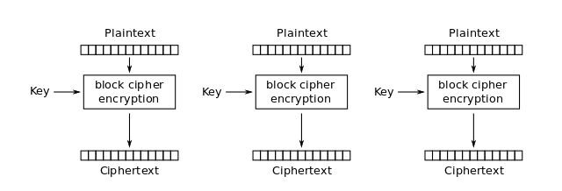
Electronic Code Book (ECB)
Each block encrypted independently (parallelization)
Processes 64-bits at a time using the same key
Decrypting starts at beginning of ciphertext (reverses the encryption process)
Notes:
Electronic Code Book (ECB) The simplest encryption mode to understand and the least
secure. Each time the algorithm processes a 64-bit block, it simply encrypts the block using
the chosen secret key. This means that if the algorithm encounters the same block multiple
times, it produces the same encrypted block. Sybex 8th ed.
Native block mode
Given message will always produce the same ciphertext
Fast and simple, but very susceptible to known plaintext attack
Simplest method and used for very short messages (less than 64bits in length)
Used to encrypt very short messages (swipe cards)
Called codebook because it is similar to having a large codebook containing every piece of 64-bit plaintext input and all possible 64-bit ciphertext outputs
Security issue is that each block is encrypted with the exact same key:
Identical plaintext with identical keys encrypts to the identical ciphertext
An attacker could uncover the key and use it to decrypt all blocks of data
An attacker could gather ciphertext and plaintext of each block and build the code book that was used, without needing the key
Not enough randomness with encrypting independent blocks; if used to encrypt a large amount of data, it could be cracked more easily than other modes
Why use? This is the fastest and easiest mode, so used to encrypt small amounts of data (such as PINS, challenge-response authentications processes, and encryption keys)
WEAKEST- NO IV, NO CHAINING, LEAVES PATTERNS
FASTEST
Sources:
(ISC)2 CBK 2008 (pgs. 238-245)
Shon Harris CISSP All-in-One Exam Guide 4th Edition (pgs. 698-702)

Slide 18
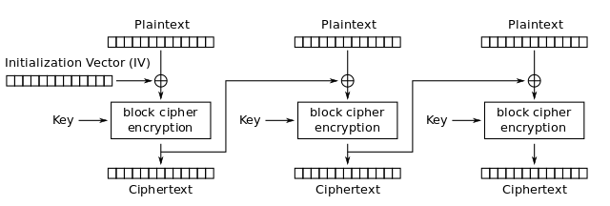
Cipher Block Chaining (CBC)
Most common mode
Loaded sequentially and XORed using 64-bit IV (blocks)
Notes:
Cipher Block Chaining (CBC) A process in which each block of unencrypted text is XORed with the block of ciphertext immediately preceding it before it is encrypted using the DES algorithm. Sybex 8th ed.
First ciphertext XORed with next text block
Process repeated until end of plaintext
Since the IV is different each time, the ciphertext is also different
Used for encrypting document files, bulk encryption, and in authentication
Any errors early in the encryption process is propagated throughout the entire process
Stronger than ECB in that each input block will produce a different output, even if blocks are identical
Sender and receiver must know the IV
ENCRYPTION ERRORS CAN PROPAGATE
DES 64 bit block , 2(32) x 8 equals 32gb safely sent before collisions
AES 128 bit block, 2(64) x 16 equals 256 Exabytes without collision
Sources:
(ISC)2 CBK 2008 (pgs. 238-245)
Shon Harris CISSP All-in-One Exam Guide 4th Edition (pgs. 698-702)

Slide 19
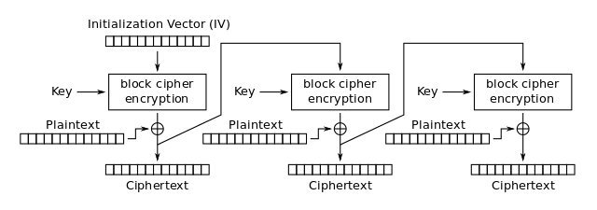
Cipher Feedback (CFB)
Emulates a Stream Cipher: Data is encrypted in units smaller than the block size (bits or bytes)
Notes:
Cipher Feedback (CFB) A mode in which the DES algorithm is used to encrypt the preceding
block of ciphertext. This block is then XORed with the next block of plaintext to
produce the next block of ciphertext. Sybex 8th ed.
Uses seed for IV
Plaintext patterns are concealed by XOR operation
Previous ciphertext block is encrypted and output produced is combined with plaintext block using XOR, to produce next ciphertext block
Used for streaming communications and authentication
Usually encrypts 8 bits at a time (size of a character)
Good for 8 bit blocks
Previous ciphertext block is encrypted and the left-most 8 bits of the 64-bit cyphertext output produced is combined with the next
plaintext block using XOR, to produce next ciphertext block
Drawback is that if a bit is corrupted or altered, all of the data from that point forward will be damaged
STEAMING VIDEO, TERMINAL TO TERMINAL SYSTEMS
Similar to CBC but is streaming (ERRORS CAN PROPOGATE)
Sources:
(ISC)2 CBK 2008 (pgs. 238-245)
Shon Harris CISSP All-in-One Exam Guide 4th Edition (pgs. 698-702)

Slide 20
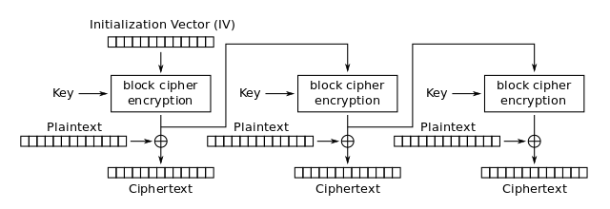
Output Feedback (OFB)
Similar to CFB, except quantity XORed with each plaintext block is generated independently of plaintext and ciphertext
Notes:
output feedback (OFB) A mode in which the Data Encryption Standard XORs plaintext
with a seed value. For the first encrypted block, an initialization vector is used to create the
seed value. Future seed values are derived by running the DES algorithm on the preceding
seed value. The major advantage of OFB mode is that transmission errors do not propagate
to affect the decryption of future blocks. Sybex 8th ed.
Emulates a stream cipher
IV is used as a seed, then the keystream (the output of encryption function) is used as the IV when continuing the process and is fed back into the shift register
Very strong, similar to one time pad
Encrypting 64-bit IV with secret key generates DES keystream
Used for authentication and digital video
Used for encrypting digitized video or digitized voice signals
Differs from CFB on how feedback is accomplished
ERRORS DO NOT PROPAGATE as subkey is used before it is XORed to plaintext
DIGITIZED VOICE AND VIDEO
Sources:
(ISC)2 CBK 2008 (pgs. 238-245)
Shon Harris CISSP All-in-One Exam Guide 4th Edition (pgs. 698-702)

Slide 21
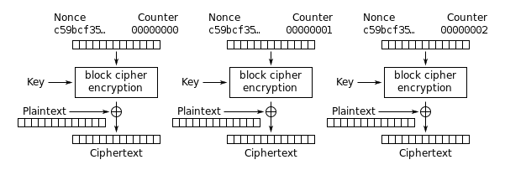
Counter Mode (CTR)
Similar to OFB mode: Instead of a static IV, a counter is incremented with each data block
Each block XORed with a unique keystream value
Notes:
Similar to OFB except in how feedback is accomplished
No chaining involved; since chaining is not involved, the destination can begin processing the packets without having to wait for the full message to arrive and then decrypt
Encryption of blocks can happen in parallel (increases performance)
Used in IPSec and ATM transmissions for streaming communications (high speed apps)
Used in AES, implemented in 802.11i wireless LANS
Integer Counter is called nonce (starting with 0)
NO PATTERNS AND NO ERROR PROPAGATION as rounds are done in parallel
Good performance, no chaining
ATM CELLS, 802.11, IPSEC
Sources:
(ISC)2 CBK 2008 (pgs. 238-245)
Shon Harris CISSP All-in-One Exam Guide 4th Edition (pgs. 698-702)

Slide 22
Counter Mode with Cipher Block Chaining Message Authentication Code Protocol (CCMP)
AES CCMP requires 128 bit key and 128 bit block size
48 bit IV to minimize replay attacks
CBCMAC used to produce Message Integrity Code (MIC)
Included in 802.11i standard
AES-CCMP produces a higher level of security over past protocols
Notes:
CCMP (Counter Mode with Cipher Block Chaining Message Authentication Code Protocol) The designed replacement for WEP and TKIP/WPA. It implements AES (Advanced
Encryption Standard) with a 128-bit key as a stream cipher. Sybex 8th ed.

Slide 23
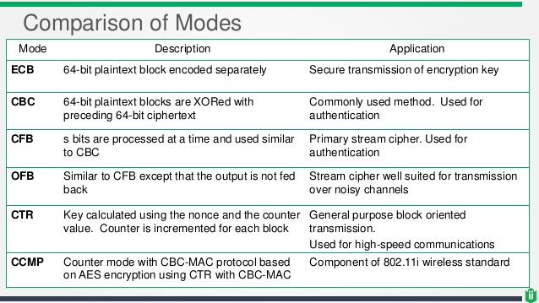

Slide 24
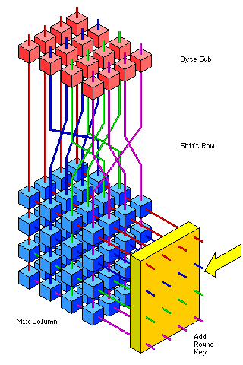
Advanced Encryption Standard (AES)
Replacement for DES/3DES
Uses the Rijndael algorithm (beat out: RC6, serpent, mars, twofish)
Only Block size: 128 (not 192 and 256) per FIPS 197
Variable Key sizes: 128, 192, and 256
Uses a variable number of rounds (10, 12, 14)
4 major operations that provide confusion, diffusion, and XOR
Subbytes
Shift Row
Mix Columns
Add Round Key
Notes:
Advanced Encryption Standard (AES) The encryption standard selected in October
2000 by the National Institute of Standards and Technology (NIST) that is based on the
Rijndael cipher. Sybex 8th ed.
Advanced Encryption Standard (AES): AES was announced by NIST as U.S. FIPS 197 on November 26, 2001, after a 5-year standardization process in which fifteen competing designs were presented and evaluated before Rijndael was selected as the most suitable. Five finalists (MARS-IBM, Twofish, RC6-RSA, Serpent, Rijndael). AES requirements were security, efficiency, flexibility, and royalty free. As of 2006, AES is one of the most popular algorithms used in symmetric key cryptography.
Although AES is now an accepted standard, there are not many implementations of it because DES has been the standard for so long now.
Has low memory requirements
Easily to defend against timing attacks
PRONOUNCED “RHINE DAHL”
Developed by Dr. Joan Daemon and Dr. Vincent Rijman
Uses the Rijndael Block Cipher which is resistant to all known attacks
Uses a variable number or rounds depending on the block and key size
If both key and block size are 128 bits, there are 10 rounds
If both key and block size are 192 bits, there are 12 rounds
If both key and block size are 256 bits, there are 14 rounds
AES has been implemented mostly in software; DES has been often implemented in hardware, which means that in order to switch to AES, the hardware must be upgraded and can become very costly
4 major operations:
Subbytes - S-Box
Shift Rows - block wide transposition
Mix Columns - multiplying and XOR
Add Round Key - key modified for each round
Sources:
(ISC)2 CBK 2008 (pgs. 247-250)
Shon Harris CISSP All-in-One Exam Guide 4th Edition (pgs. 703-704)

Slide 25
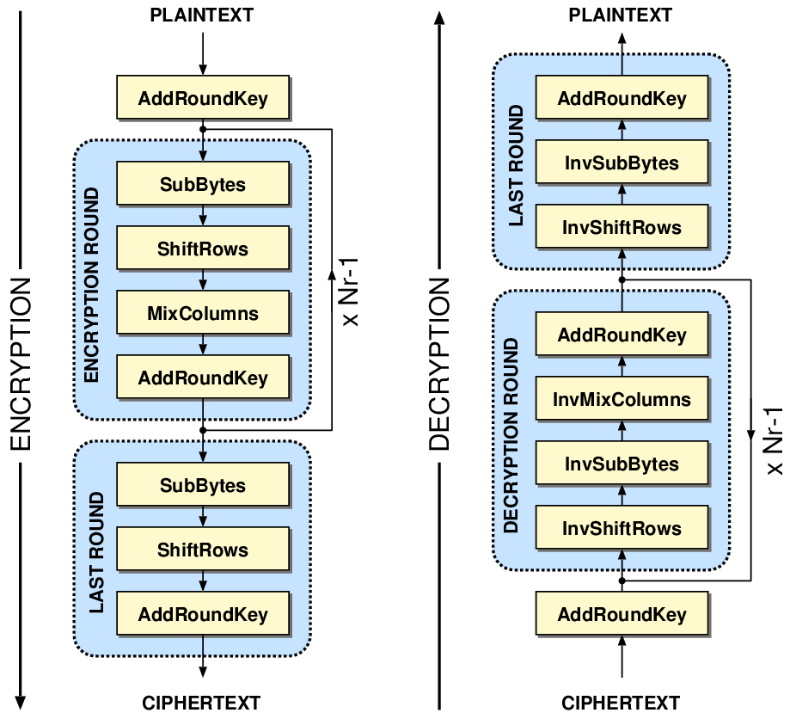
ALGORITHM
10 cycles of repetition for 128-bit keys.
12 cycles of repetition for 192-bit keys.
14 cycles of repetition for 256-bit keys.

Slide 26
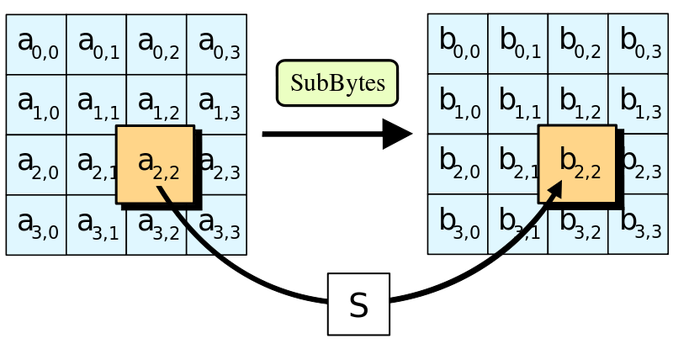
Algorithm Steps - Sub bytes
each byte in the state matrix is replaced with a SubByte using an 8-bit substitution box
b_{ij} = S(a_{ij})

Slide 27
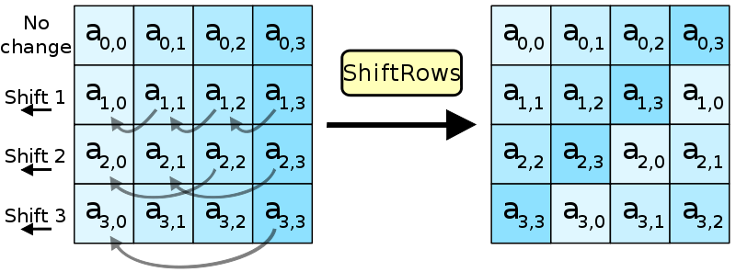
Shift Rows
Cyclically shifts the bytes in each row by a certain offset
The number of places each byte is shifted differs for each row

Slide 28
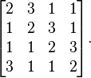
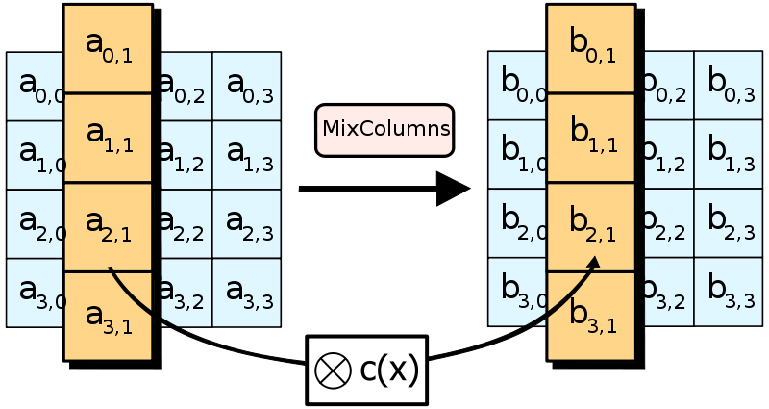
Mix columns
Each column is multiplied by the known matrix. For the 128-bit key it is

Slide 29
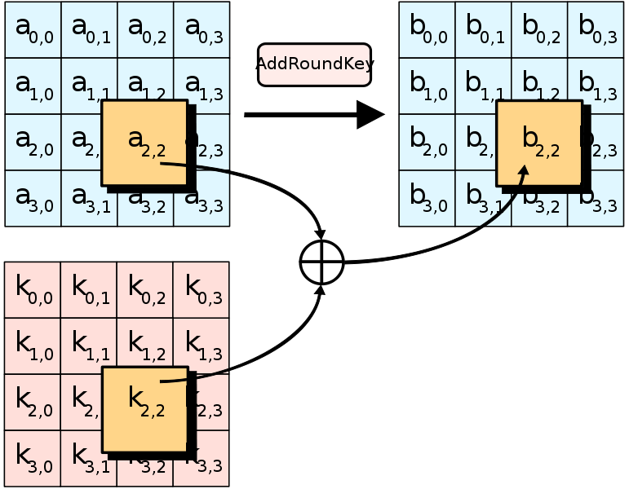
Add round key
Each byte of the state is combined with a byte of the round subkey using the XOR operation

Slide 30
Uses for AES today
Government Standard
AES is standardized as Federal Information Processing Standard 197 (FIPS 197) by NIST
AES 128 is sufficient to protect classified information up to the SECRET level.
TOP SECRET information will require use of either the 192 or 256 key lengths.
Industry
SSL / TLS / SSH
WinZip / 7-Zip
BitLocker / Vera Crypt
Skype/Teams

Slide 31
Asymmetric Key Encryption
Plaintext
Ciphertext
Recipient’s Public Key
Hash
Asymmetric Keys
Sender’s Private Key
Two keys
Public / Private
Slow
Plaintext
Ciphertext
Recipient’s Private Key
Hash
Sender’s Public Key
Notes:
asymmetric key A form of cryptography that does not use symmetric keys. It either uses
complex formulas to solve problems (such as Diffie-Hellman to generate/exchange symmetric
keys) or uses key pair sets to provide digital signatures and digital envelopes. This latter
form is also known as public key cryptography. Sybex 8th ed.

Slide 32
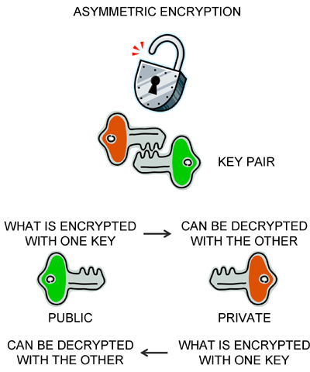
Asymmetric Algorithms
Uses different keys for encryption and decryption
Each user has two keys: public & private key
Both keys together are called the key pair
Keys are mathematically related
Public key is derived from private key
Public key made available to anyone
Private key kept secret
Notes:
Asymmetric – aka: Public Key encryption; Normal key lengths: >= 526
Both keys are required to perform an operation
Data encrypted with the private key is unencrypted with the public key (open message format)
Data encrypted with the public key is unencrypted with the private key (confidentiality)
Used in key exchange, email security, web security, and other encryption systems that require key exchange over the public network
Decryption key cannot be calculated from the encryption key
In the case of a key exchange, one party creates the secret key and encrypts it with the public key of the recipient; the recipient would then decrypt it with their private key; the remaining communication would be done with the secret key being the encryption key
* Ask students if it makes sense to encrypt data with the sender’s public key. No: doesn’t give a digital signature.
Number of Keys Needed Example:
100 people: 100 * 2 = 200 keys
If the private key is ever discovered, a new key pair must be generated
The public/ private key works with each to create the trap door function
A 512 bit public key is equivalent to a 64 bit secret key
CPU Cycle eating algorithms (high overhead)
Sources:
(ISC)2 CBK 2008 (pgs. 253-254)
Shon Harris CISSP All-in-One Exam Guide 4th Edition (pg. 706)

Slide 33
Asymmetric Algorithms
Encrypting data with the sender’s private key provides proof of origin, without confidentiality
Ensures the message has come from the stated sender
Open message format
Signing a message with the sender’s private key creates a digital signature
Provides nonrepudiation
Notes:
Other algorithms:
LUC based on Lucas Sequences (similar to ElGamal)
Knapsack based on the knapsack problem (computing values of binary numbers)
Sources:
(ISC)2 CBK 2008 (pgs. 254-258)
Shon Harris CISSP All-in-One Exam Guide 4th Edition (pgs. 706-712)

Slide 34
Asymmetric Algorithms
Diffie-Hellman – From previous unit. Used to securely exchange keys over a public channel by exchanging public keys and mixing it with their private keys (recall the paint mixing example?)
Elliptic-Curve Cryptography (ECC) – Used in digital signatures, pseudo-random generators, etc.
ElGamal – Based on DH, used in GPG/PGP.
RSA – Widely used today. Also one of the oldest. Relies on the difficulty of factoring.
DSA/DSS – A variant of ElGamal and a FIPS for digital signatures, which is now deprecated.

Slide 35
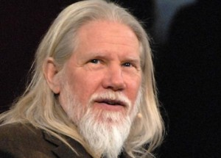

Diffie-Hellman Algorithm
First public-key agreement algorithm
Not used for message encryption or digital signatures (only used for key exchange)
Uses discrete logarithms containing large prime numbers
A logarithm is the opposite of exponentiation (7 to the 13th power)
Example: 96, 889,010,407 is 7 to what power? Find the logarithm (more difficult)
Requires both the sender and receiver of a message to have key pairs
Most well-known “forward secrecy” (perfect forward secrecy) mechanism.
Whitfield Diffie
Martin Hellman
Notes:
Diffie–Hellman algorithm A key exchange algorithm useful in situations in which two
parties might need to communicate with each other but they have no physical means to
exchange key material and there is no public key infrastructure in place to facilitate the
exchange of secret keys. Sybex 8th ed.
First published publicly by Whitfield Diffie and Martin Hellman in 1976.
Like RSA, it also uses large prime numbers to generate its public key, usually 1024 bits in length.
Vulnerable to Man-in-the-Middle attacks if not used with another authentication application. This vulnerability is present because Diffie-Hellman key exchange does not authenticate the participants.
Diffie Hellman Key agreement protocol used to exchange keys.
Discrete logarithms – apply logarithms to groups
Sources:
(ISC)2 CBK 2008 (pgs. 254-258)
Shon Harris CISSP All-in-One Exam Guide 4th Edition (pgs. 706-712)
http://www.rsa.com/rsalabs/node.asp?id=2248

Slide 36
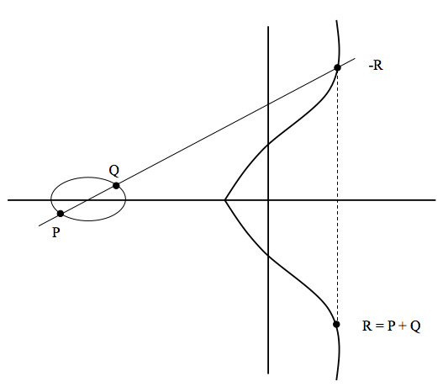
Elliptical Curve Cryptography
Provides Encryption, Digital Signatures, and Key Exchange
Highest strength per bit of key length
Uses shorter keys, most efficient asymmetric algorithm
An ECC key of 160 bits is equivalent to a 1024-bit RSA key
Used in Wireless Devices
Suitable for hardware applications
Notes:
elliptic curve cryptography A new branch of public key cryptography that offers similar
security to established public key cryptosystems at reduced key sizes. Sybex 8th ed.
Use of shorter keys saves on computational power and bandwidth
An elliptic curve key of 160 bits is equivalent to 1024-bit RSA key, which means less computational power and memory requirements
Suitable for hardware applications (e.g. smart cards and wireless devices)
Discrete logarithms applied to elliptical curve; harder to solve than discrete logarithms but numbers are smaller
Same functionality as RSA
All must agree on parameters, field is defined by primecase value; 2003 primefield (finite field) broken (109 bit key broke using 10,000 computers for 540 days); 2004 binary field (finite field, polynomial base) broken (2600 computers for 17 months)
Uses Diffie Hellman key agreement protocol
ECC DSA based on DSA
MOST EFFICIENT
Sources:
(ISC)2 CBK 2008 (pgs. 254-258)
Shon Harris CISSP All-in-One Exam Guide 4th Edition (pgs. 706-712)

Slide 37
Rivest, Shamir, Adleman (RSA)
Based on factoring of large prime numbers (integer factorization)
Which Prime Number Times Which Prime Number Equals 49,418,527
Example: 6269 x 7883 = 49,418,527
Provides Encryption, Digital Signatures, and Key Exchange
Variable key length and block size 512 to 4096
Strong, but very slow in speed
100 times slower than conventional encryption in software
1,000 – 10,000 times slower that conventional encryption in hardware
Notes:
Rivest, Shamir, and Adleman (RSA) A public key encryption algorithm named after
Rivest, Shamir, and Adleman, its inventors. Sybex 8th ed.
Developed in 1978 at MIT.
RSA is reversible, can encrypt or decrypt with either key
Security of algorithm comes from the difficulty of factoring large prime numbers.
Factoring is taking a number and finding the numbers that can be multiplied together to calculate that number. (If a*b = c, then c can be factored into a and b). Example of prime number calculation: n=17*11=187
Can be used as a key exchange protocol, meaning it is used to encrypt the symmetric key to get it securely to its destination.
When RSA is used as a key exchange protocol, a cryptosystem generates a symmetric key using either DES or AES.
The system encrypts the symmetric key with the receiver’s public key and sends it to the receiver.
The symmetric key is protected because only the individual with the corresponding private key can decrypt and extract the symmetric key.
Key length and block size: 512, 768, 1024, 2048, 3072, and 4096.
The government uses mostly 4096 in its transactions, which requires mini super computers to run.
Why so slow is once again going back to key lengths. Remember, the larger the key, the slower it will be to encrypt and decrypt, but you get outstanding security.
Asymmetric algorithms (except for ECC) are inherently weaker per bit length than symmetric algorithms. Therefore asymmetric algorithms must be made very large to compensate. When they are increased in size, asymmetric algorithms then become very complex, thus the “slowness” of asymmetric algorithms.
Factoring-which prime # by which prime # equals another prime #
Public key – large composite # divisible by 1, itself, and other numbers
Prime number – used to create public key and if kept private serve as the private key
Sources:
(ISC)2 CBK 2008 (pgs. 254-258)
Shon Harris CISSP All-in-One Exam Guide 4th Edition (pgs. 706-712)

Slide 38
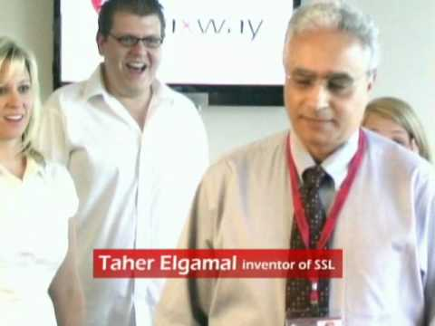
El Gamal
Based upon the Diffie-Hellman
Provides Encryption, Digital Signatures, and Key Exchange
Discrete logarithms (easy to reverse re-engineer)
Main drawback is performance (slower than other comparable algorithms)
Notes:
El Gamal The explanation of how the mathematical principles behind the Diffie-Hellman key exchange algorithm could be extended to support an entire public key cryptosystem used for the encryption and decryption of messages. Sybex 8th ed.
Based not on the difficulty of factoring large numbers, but on calculating discrete logarithms in a finite field
SLOWEST
Uses a finite field which is slower than RSA
Sources:
(ISC)2 CBK 2008 (pgs. 254-258)
Shon Harris CISSP All-in-One Exam Guide 4th Edition (pgs. 706-712)

Slide 39
Symmetric Key Lengths vs. Asymmetric Key Lengths
Symmetric Key Length | Symmetric Algorithm | Discrete Logarithm Equivalent Key Length | Factoring Prime Number Equivalent Key Length | ECC Equivalent Key Length
112 | 3DES | 2048 | 2048 | 224-255
128 | AES | 3072 | 3072 | 256-283
192 | AES | 7860 | 7860 | 384-511
256 | AES | 15,360 | 15,360 | Above 512

Slide 40
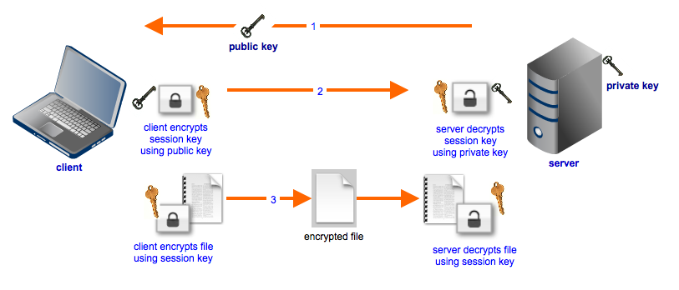
Hybrid Encryption Methods
Method for maintaining integrity, confidentiality, and authentication
Constructed using two or more cryptosystems:
Hashing for Integrity
Symmetric for Bulk Encryption
Asymmetric for Key Encapsulation
Used in:
SSL/TLS
Email
Key Exchange
Notes:
Combines the convenience of an asymmetric cryptosystem with the efficiency of a symmetric cryptosystem.
Digital envelope: Serves as a means of access control by ensuring that only the intended recipient can open the message (because only the receiver will have the private key necessary to unlock the envelope; this is also known as receiver authentication).
For very long messages, the bulk of the work in encryption/decryption is done by symmetric-key scheme, while the public-key scheme is used only to encrypt/decrypt a short key value.
PKI Public key encrypts and signature verification
PKI Private key decrypts and generates signatures
Hybrid Sending Process:
Hash is created with ICV: ICV = Integrity Check Value (hash + timestamp); ICV is random number
ICV is encrypted with Sender’s Private Key
Random session key created (usually from the movement of the user’s mouse and/or keystrokes)
Session key is run through a symmetric algorithm (such as 3DES), generating a one-time secret key
Message is encrypted with the one-time secret key
Authentication Block is created with the Session Key, Signed Hash, and Sender’s ID
Authentication block is then encrypted with the recipient’s public key, using asymmetric encryption
Each recipient uses the corresponding private key (symmetric) to decrypt the session key
Once all parties have obtained the session key they can use a much faster symmetric algorithm to encrypt and decrypt messages
Essentially a public key system (asymmetric)
Used for speed
Note that for very long messages, the bulk of the work in encryption/decryption is done by the more efficient symmetric key scheme, while the asymmetric key scheme is used only to encrypt/decrypt the short symmetric key value.

Slide 41
Message Authentication Codes (MAC)
a.k.a: Message Integrity Code; Modification Detection Code; Cryptographic Checksum
Used to verify integrity and data origin (two ways):
Value generated by running a message through a block cipher (CBC) or a hash function
Recipient creates a MAC using the same secret key and compares it to the MAC received
Requires the sender and the receiver to share a secret key
Notes:
The purpose of a MAC is to authenticate (really data origin, because 2 parties share the same key) both the source of a message and its integrity without the use of any additional mechanisms. Different than digital signatures, MACs are computed and verified with the same key, so that they can only be verified by the intended recipient.
MAC values resulting from running it through DES can be 16 or 64 bits in length.
Sources:
(ISC)2 CBK 2008 (pgs. 264-265)
Shon Harris CISSP All-in-One Exam Guide 4th Edition (pgs. 714-718)

Slide 42
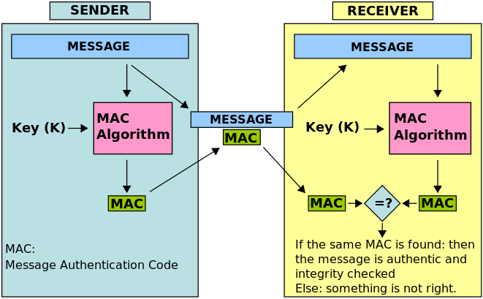
Message Authentication Codes (MAC)
Notes:
The purpose of a MAC is to authenticate (really data origin, because 2 parties share the same key) both the source of a message and its integrity without the use of any additional mechanisms. Different than digital signatures, MACs are computed and verified with the same key, so that they can only be verified by the intended recipient.
MAC values resulting from running it through DES can be 16 or 64 bits in length.
Sources:
(ISC)2 CBK 2008 (pgs. 264-265)
Shon Harris CISSP All-in-One Exam Guide 4th Edition (pgs. 714-718)

Slide 43
Message Authentication Codes (CBC-MAC and CMAC)
Constructed using any block cipher
AES commonly used
Message encrypted in CBC mode
MAC tag is the last block of cipher text generated by the algorithm (16 - 64bits)
Size of the MAC is limited to the size of the last block
CMAC is stronger than CBC-MAC
Pads the last block and uses 2 keys
Slower than HMAC
Notes:
Cipher Block Chaining (CBC-MAC)
Cipher-based MAC (CMAC)
Can use any block cipher (AES or DES commonly used)
OMAC is also a variant of CBC-MAC
Sources:
(ISC)2 CBK 2008 (pgs. 264-265)
Shon Harris CISSP All-in-One Exam Guide 4th Edition (pgs. 714-718)

Slide 44

CBC-MAC and CMAC
Plaintext
Plaintext
Plaintext
IV
XOR
XOR
XOR
Key
Material
Block Cipher
Encryption
Key
Material
Block Cipher
Encryption
Key
Material
Block Cipher
Encryption
Ciphertext
Ciphertext
Ciphertext
MAC tag

Slide 45
Hashed Message Authentication Codes (HMAC)
Type of MAC calculated using a hash function in combination with a secret key
The shared secret key is appended to the data to be hashed
Uses MD5 or SHA-1
Used in Internet Protocols such as IPSec, SSL/TLS, and SSH
Creates a more rapid message digest (CBC-MAC and CMAC uses block chaining, which is slow)
Notes:
Hashed Message Authentication Code (HMAC) An algorithm that implements a partial
digital signature—it guarantees the integrity of a message during transmission, but it does
not provide for nonrepudiation. Sybex 8th ed.
HMAC
As with any MAC, it may be used to simultaneously verify both the data integrity and the authenticity of a message
Any iterative cryptographic hash function, such as MD5 or SHA-1, may be used in the calculation of an HMAC; the resulting MAC algorithm is termed HMAC-MD5 or HMAC-SHA-1 accordingly
A hash function such as MD5 was not designed for use as a MAC and cannot be used directly for that purpose because it does not rely on a secret key.
Allows for easy replaceability of the underlying hash function in the event that faster or more secure hash functions are later available.
HMAC – concatenate message and key together, hash both when together
CBC-MAC encrypt message with symmetric key in CBC mode, last block of cipher text is MAC
2 algorithms needed for HMAC: shared secret key, hash message (encrypt hash with key and symmetric algorithm)
Sources:
(ISC)2 CBK 2008 (pgs. 264-265)
Shon Harris CISSP All-in-One Exam Guide 4th Edition (pgs. 714-718)
http://csrc.nist.gov/publications/fips/fips198/fips-198a.pdf
http://www.ddj.com/architect/184410908

Slide 46
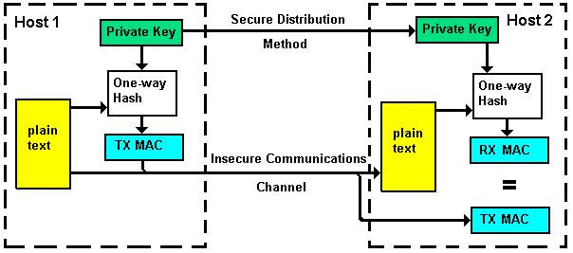
Hashed Message Authentication Codes (HMAC)

Slide 47
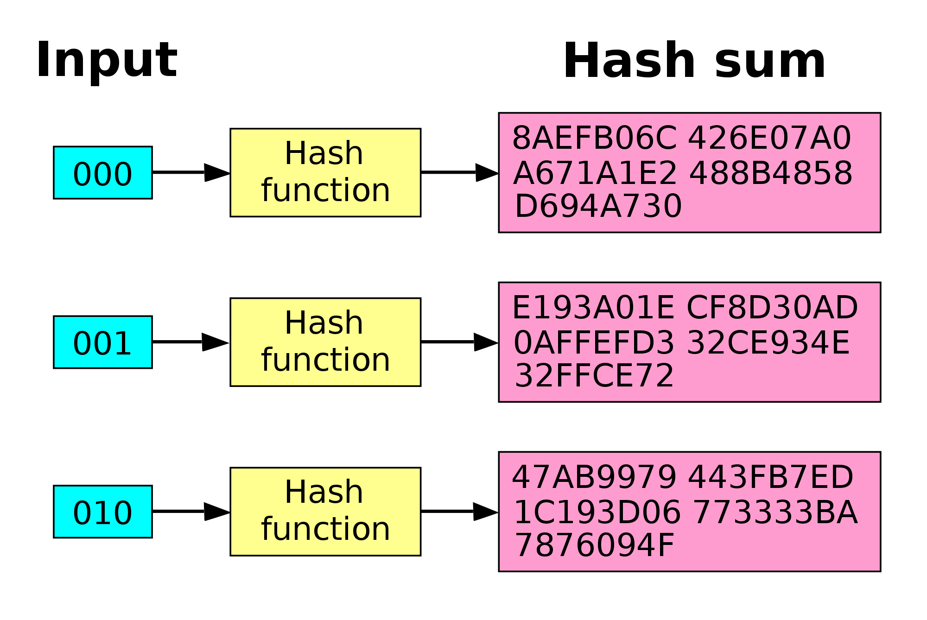
Hashing – Avalanche Effect (Determinism)
Notes:
This demonstrates a hashes avalanche effect. Change a bit and the results will change

Slide 48
Hashing Algorithms
A function that takes a variable-length string, and compresses and transforms it into fixed-length output
The fixed-length output is called a hash or message digest
Ensures data integrity
Formula or method is public
Used to create checksums, message digests, or integrity check values (ICV)
Notes:
Hashing value - aka Message Digest, File Fingerprint, hash
Hashing Algorithm – aka Nonkeyed Message Digest
Encryption via an algorithm with no key
AKA: modification detection code MDC; message integrity code MIC
Sources:
(ISC)2 CBK 2008 (pgs. 260)
Shon Harris CISSP All-in-One Exam Guide 4th Edition (pgs. 719)
http://www.fileformat.info/tool/hash.htm

Slide 49
Hashing Algorithms
Name | Class | Hash Length
MD5 | 512-bit blocks | Digest size(s): 128 bits Rounds: 4 32 character output
SHA-1, | 512-bit blocks | Digest size(s): 160 bits Rounds: 80 40 character output
SHA-2 SHA-224/256 | 512-bit blocks | Digest size(s): 256 bits Rounds: 64 56/64 character output
SHA-2 SHA-384/512 | 1024-bit blocks | Digest size(s): 512 bits Rounds: 80 92/128 character output
RIPEMD-160 | 512-bit blocks | Digest size(s): 160 Rounds: 5 paired rounds of 16 steps (160)
HAVAL | 1024-bit blocks | Digest size(s): 128 bits, 160 bits, 192 bits, 224 bits, and 256 bits Rounds 3, 4, or 5
WHIRLPOOL | 512-bit blocks | Digest size(s): 128 bits Rounds 10
Notes:
MD5 – Developed by Ron Rivist at MIT in 1992
Several attacks developed against MD5, where it is now possible to find collisions through analysis.
MD2 (slow), MD4 (faster), MD5 (fastest)- all are 128 bit (MD6-2008)
SHA-1 – Designed by NSA to be used with DES. Used for DSA. Standard DoD hashing algorithm. 1993, (SHA-2 2001)
RIPEMD – The European RACE Integrity Primitives Evaluation project developed RIPEMD in response to vulnerabilities found in MD4 and MD5. Does twice the processing of SHA-1.
HAVAL – A variable length one-way hashing algorithm that supports 15 different levels of security.
Tiger - used in 64-bit systems, is 128, 160, or 192 bit , designed to be faster than MD-5 and SHA-1
Whirlpool - based on AES 512 message digest. Can handle messages up to 2(256) in length; output is bit size divided by 4
FIPS 180.3 recognizes SHA-1, 224, 256, 384, 512 (SHA-3 competition underway)
Hashes have 3 properties:
Collision resistance – can’t find collisions, rating based on twice hash length
Preimage resistance – can’t work backwards, rating based on hash length
Secondary primary resistance – two messages don’t create same output
Sources:
(ISC)2 CBK 2008 (pgs. 261-262)
Shon Harris CISSP All-in-One Exam Guide 4th Edition (pgs. 719-720)
www.fileformat.info/tool/hash.htm

Slide 50
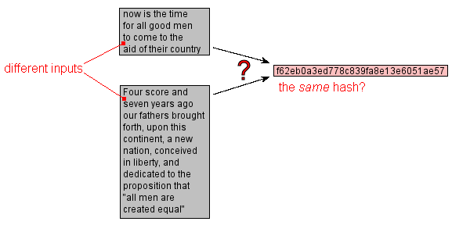
Attacks on hash Algorithms
Collisions: The probability of co-occurrence that results in faulty output or potential derivation.
Brute-force: relies on finding weaknesses in the algorithm
Birthday Paradox: Probability exploits
Notes:
Collisions: A hash collision or hash clash occurs when a hash function generates the same output for different inputs. Salts are added for collision resistance.
Brute-force
A method of defeating a cryptographic scheme by trying a large number of possibilities
Relies on finding weaknesses in the hashing algorithm that would allow an attacker to reconstruct the original message from the hash.
attempts every possible combination for a key or password; successful if given enough time
Involves using massive amounts of processing power to methodically guess the key used to secure cryptographic communications
For a non-flawed protocol, the average amount of time required to discover the key through a brute-force attack is directly proportional to the length of the key
Enough time is relative to the length of the key. Ex: a computer that could brute force a DES 56-bit key in 1 second would take up to 149 trillion years to brute force an AES 128-bit key. Every additional bit of key length doubles the time to perform a brute-force attack because the number of potential keys doubles
Birthday Paradox (aka Birthday Attack or Collision attack)
What are the odds that two people in a room have the same birthday? The more people there are in the room, the higher the probability.
There actually only needs to be 23 people in the room to increase the odds to 50% and a 50% chance that out of 254 people, one has your birthday
Applying that logic to hash collisions, the odds that a given company will have a hash collision somewhere in their environment increases with the size of their environment (analogous to the number of people in a room increasing the chances that two of them will have the same birthday)
Attacker seeks to substitute, in a digitally signed communication, a different message that produces the same message digest, thereby maintaining the validity of the original digital signature
Based on the probability of two different messages having the same hash function that produces the same message digest
HASH COLLISION Q&A
Cryptography Research has received many inquiries about the hash collision attacks that were announced at the CRYPTO 2004 conference. This document attempts to address these questions.
(This document was updated on February 16, 2005 to reflect new collision results reported against the SHA-1 algorithm.)
Q: What hash functions are now broken? A: Collisions were announced in SHA-0, MD4, MD5, HAVAL-128, and RIPEMD. Antoine Joux presented the collision in SHA-0. The collisions against MD4, MD5, HAVAL-128, and RIPEMD were found by the Chinese researcher Xiaoyun Wang with co-authors Dengguo Feng, Xuejia Lai, and Hongbo Yu. (See http://eprint.iacr.org/2004/199.pdf.) In February 2005, an (as-yet unimplemented) attack against SHA-1 was reported by Xiaoyun Wang, Lisa Yiqun Yin, and Hongbo Yu that can find collisions in SHA-1 with an estimated effort of 2^69 hash computations.
Q: What is the connection between digital signatures and hash functions? A: All major digital signature signing techniques (including DSA and RSA) involve first hashing the data then signing the hash. Raw message data is not signed because of both performance and security reasons.
Q: What are the implications for certificate authorities, such as those issuing SSL web server certificates containing MD5 or SHA-1 hashes? A: Collision attacks do not enable tampering with existing certificates. There is, however, a concern that an adversary might be able to construct a valid certificate request that had a corresponding hash collision with a certificate conferring greater or different powers. For example, a devastating attack would be one that enabled adversaries to obtain a legitimate server certificate with a collision to one containing a wildcard for the domain name and an expiration date far in the future. The use of unpredictable serial numbers early in the certificate data structure may prevent such attacks, but further research is required. From a cryptographic perspective, the best solution to this problem is to transition away from MD5, but this is difficult since many CAs and software programs currently support MD5.
Q: Is SSL 3.0/TLS affected by these results? A: The SSL 3.0 protocol (which was co-authored by Cryptography Research President & Chief Scientist Paul Kocher) uses MD5 and SHA-1 in a redundant fashion in the handshake protocol and also supports MD5 HMAC. Neither use is affected by these attacks. While there is also some concern that signing authorities could be affected (see the question above on certificate authorities), certificate formats and procedures are beyond the scope of the SSL/TLS protocol.
SALTS ADDED FOR COLLISION RESISTANCE
Sources:
(ISC)2 CBK 2008 (pgs. 220, 263-264)
Shon Harris CISSP All-in-One Exam Guide 4th Edition (pgs. 721-722)

Slide 51
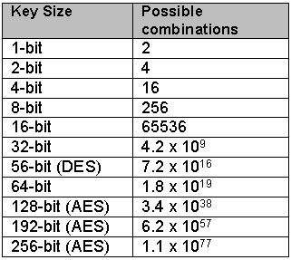
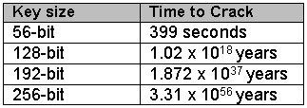
Brute Force Attack
Supercomputer: K Computer (Japan, 2011)
Speed: 10.51 Pentaflops= 10.51 x 10¹⁵ Flops [Flops = Floating point operations per second]
Flops required per combination = 1000
Checks per second = (10.51 x 10¹⁵) / 1000 = 10.51 x 10¹²
Seconds in a Year = 31536000
No. of Years to crack AES with 128-bit Key = (3.4 x 10³⁸) / [(10.51 x 10¹²) x 31536000] = (0.323 x 10²⁶)/31536000 = 1.02 x 10¹⁸ years = 1 billion billion years

Slide 52
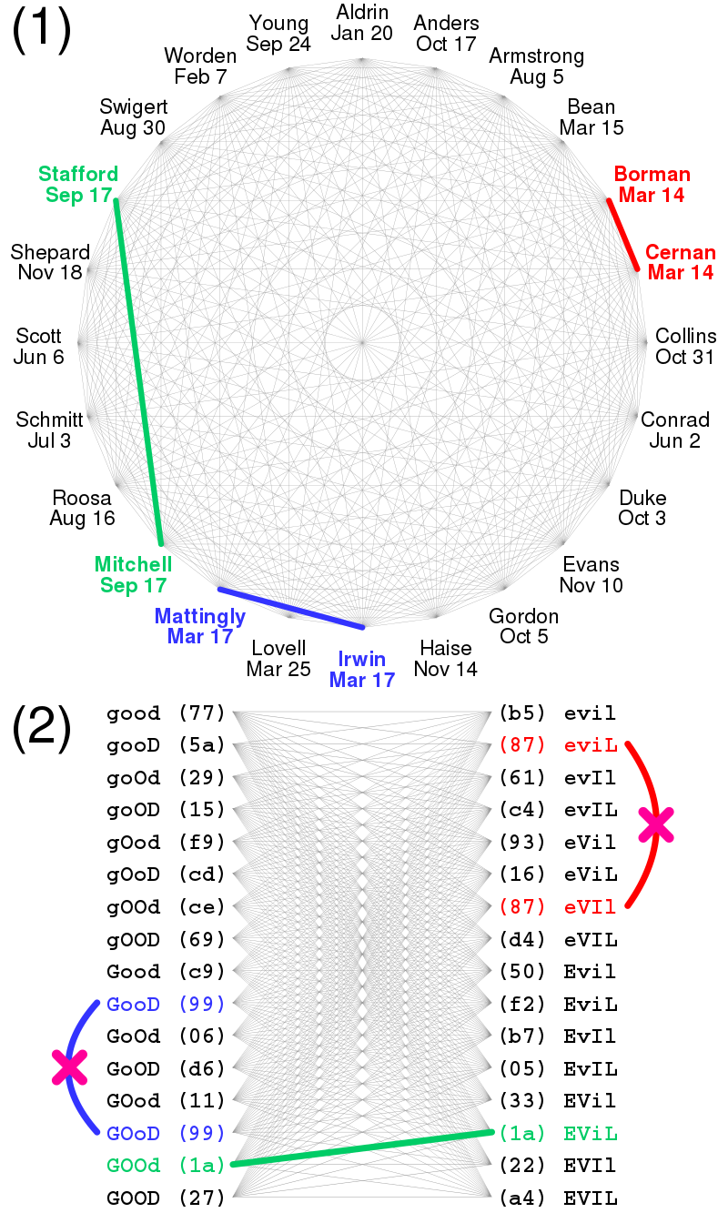
Birthday attacks
Consider the scenario in which a teacher with a class of 30 students (n = 30) asks for everybody's birthday. What are the odds that two students have the same birthday?
Intuitively, this chance may seem small – 1 in 365.
Counter-intuitively, the probability that at least one student has the same birthday as any other student on any day is around 70% (for n = 30), from the formula: 1 – 365! / (365-n)!*365^n
If the teacher had picked a specific day, then the chance that at least one student was born on that specific day is 1 – (364/365)^n, about 7.9%

Slide 53
Birthday attacks

Slide 54
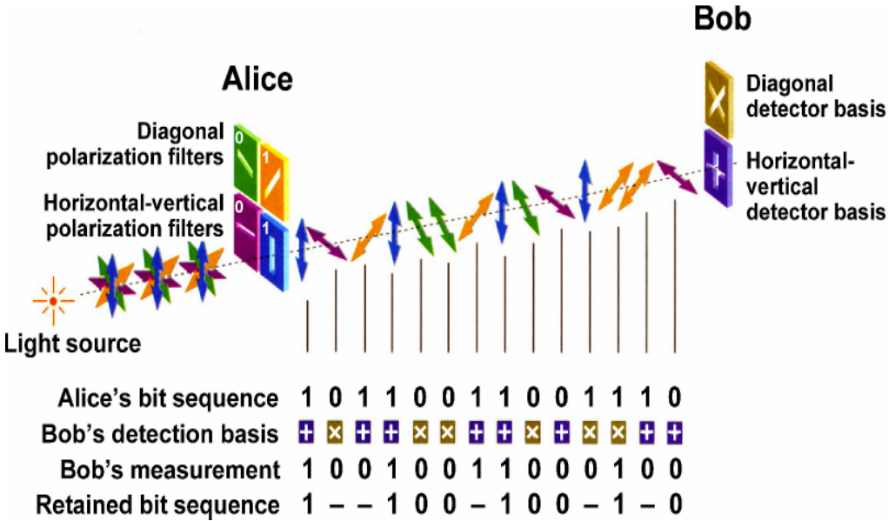
Quantum Cryptography
Based on physics rather than mathematical difficulties
Used for integrity and to generate/distribute secret keys
Million times stronger than RSA in one millionth the time (uses qubit versus bit)
Heisenberg Uncertainty Principle
In the process of measuring results, the results change
If photons intercepted, photons will change polarity
Notes:
Quantum Cryptography
NOT used to encrypt data, transfer encrypted data, or store encrypted data
Werner Heisenberg’s claim is that we cannot know both a particle’s position and momentum with unlimited accuracy at the same time.
Photon polarization used to represent bits (photons are the particles that make up light)
Used mainly in some military basis and other US gov’t agencies
Unlike traditional computers whose processing power grows linearly, the quantum machines’ power grow exponentially, blowing Moore's Law out of the water. Moving from a 128-qubit computer to today's 512-qubit machine increased processing power by 300,000 times.
In quantum mechanics, there can be no states that describe a particle with both a definite position and a definite momentum. The more precise the position, the less precise the momentum
In quantum physics, a particle is described by a wave packet, which gives rise to this phenomenon. Consider the measurement of the position of a particle. It could be anywhere. The particle's wave packet has non-zero amplitude, meaning the position is uncertain – it could be almost anywhere along the wave packet. To obtain an accurate reading of position, this wave packet must be 'compressed' as much as possible, meaning it must be made up of increasing numbers of sine waves added together. The momentum of the particle is proportional to the wave number of one of these waves, but it could be any of them. So a more precise position measurement – by adding together more waves – means the momentum measurement becomes less precise (and vice versa).
To break 128-bit RSA encryption the traditional way would take 2,000 workstations and supercomputers about eight months. For 256-bit encryption, it’s a million years. And for 600-bit encryption, it would take the age of the universe. But with quantum computing, the size of the problem doesn't matter so much, because a powerful enough quantum machine could look at all the possibilities at once.

Slide 55
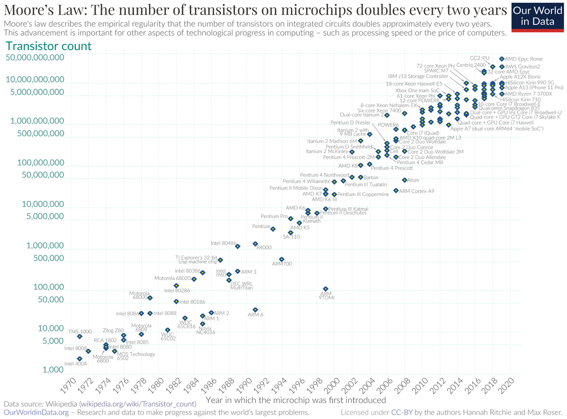

Slide 56

Public Key Infrastructure (PKI)
Developed to provide a standards for:
Key generation
Authentication
Distribution
Storage of Asymmetric Keys
Notes:
public-key infrastructure (PKI) A hierarchy of trust relationships that makes it possible to
facilitate communication between parties previously unknown to each other. Sybex 8th ed.
PKI:
Is a set of system, SW, and communication protocols required to use, manage, and control public key cryptography
Uses Public Key Cryptography (asymmetric) and Private Key Cryptography (symmetric) to provide authentication, confidentiality, integrity, and non-repudiation
Has 3 primary purposes:
Publish public keys/certificates
Certify that a key is tied to an individual/entity
Provide verification of the validity of a public key
Key Generation:
Automated methods generate strong keys and are designed for user transparency and policy enforcement
Must have a high work factor which can be contributed to the level of randomness
Pseudo randomness – randomness generated by a computer
Random number generators are used
Sources:
(ISC)2 CBK 2008 (pgs. 269-270)
Shon Harris CISSP All-in-One Exam Guide 4th Edition (pgs. 725-733)

Slide 57
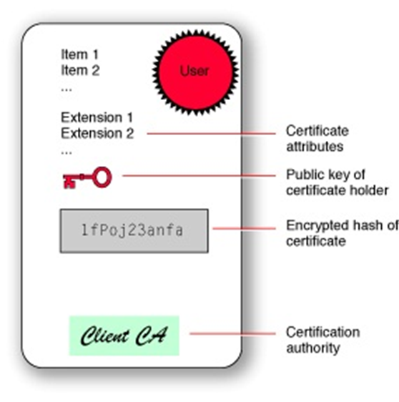
Public Key Infrastructure (PKI)
X.509 (PKI)
Most widely used standard for defining digital certificates
Defines what can go into a certificate, usage, authorities, etc.
Not used with Pretty Good Privacy (PGP) / GNU Privacy Guard (GPG)
Notes:
Entrust and Verisign – most used private sector CAs

Slide 58
X.509v3 Certificates
Binds a distinguished name to a public key
Distinguished name abbreviations:
Uid –user ID
e – email address
cn – the user’s common name
o – organization
c – country
Distinguished name is also used in the Lightweight Directory Access Protocol (LDAP)
Notes:
Users verify sender’s identity with information that is bound to the public key
Example:
Create a new e-mail (in Outlook)
Subject and Body
Send to us.army.mil account
From Message menu at far right, select under Options,
The envelope icon for “Digitally Sign Message”
The envelope icon for “Encrypt” (message)
Send (may have to enter CAC pin)
Open message (sent to the us.army.mil account)
Click on the blue lock (too far right of signed by (above the Body)
A pop-up will appear showing details of certificate (Message Security Properties)

Slide 59
X.509v3 – Components
Certificate Authority (CA)
Creates certificates to authorized users
Registration Authority (RA)
Used to offload the work of the CAs
Validates subscriber’s identity
Distributes keys
Certificate Server
Maintains a database (repository) that stores the certificates
Notes:
certificate authority (CA) An agency that authenticates and distributes digital certificates. Sybex 8th ed.
Certificate Authority (CA)
Trust begins with the root CA.
Signs certificates with its private key
Users are referred to as subscribers
Public CAs operate via the internet
Private CAs operate in organizations
registration authority (RA) A read-only version of a certificate authority that is able to
distribute the CRL and perform certificate verification processes but is not able to create
new certificates. An RA is used to share the workload of a CA. Sybex 8th ed.
Registration Authority (RA) - Does not issue certificates
Also referred to as LRA (Local Registration Authority)
Certificate Server:
Allows administrator to set policies in one location and to centrally manage all users certificates.
Microsoft Windows Server 2000/2003 can function as its own certificate server.
Sources:
(ISC)2 CBK 2008 (pgs. 269-270)
Shon Harris CISSP All-in-One Exam Guide 4th Edition (pgs. 725-733)

Slide 60




PKI – Trust Models
CA
Establish a trust model when dealing with PKI environments
Four different types:
Single Authority Trust (also known as the third-party trust)
Hierarchical Trust
Hybrid Cross Certification
Web of Trust (aka the Mesh Model)
CA
Trust between Root CAs
CA
Root CA
Intermediate CA
Leaf CA
Notes:
Single Authority Trust:
A third-party central certifying authority signs a certificate and authenticates the owner of the key
Users trust the authority and, by association, trust all keys issued by that authority
Hierarchical Trust:
The Root CA is typically responsible for authentication outside the organization
Intermediate and Leaf CAs are distributed throughout the organization to facilitate registration and distribution of certificates
Each level is updated by the other levels
Root CA’s public key is the most trusted key
Designed by establishing the subordinate trust relationships between the root CA and the subordinate CAs
Each subordinate CA can establish its own subordinate relations with the other CAs
Resulting hierarchical architecture looks like a tree, in which the trusted anchor plays the role of a root their organization may consist of tens thousand users
Hybrid-Cross Certification:
Combination of hierarchical and mesh models
This is when two or more separate authorities establish a trust relationship among each other
This model is best suited for peer-to-peer relationships, such as business partners
Represents a cross-certification among the root CA of the different hierarchical structures
Can take place at the merge of the different companies or in establishment of the strategic partnership
Results in eliminating the trusted distribution of the root CA certificate belonging to one organization among the users within the other organization may consist of tens thousand users
Web of Trust:
All parties involved trust each other equally
There is no CA to certify certificate owners
Designed by an establishment of horizontal trust relationships between others
PGP is an example of Web of Trust
Sources:
(ISC)2 CBK 2008 (pgs. 269-270)
Shon Harris CISSP All-in-One Exam Guide 4th Edition (pgs. 725-733)

Slide 61
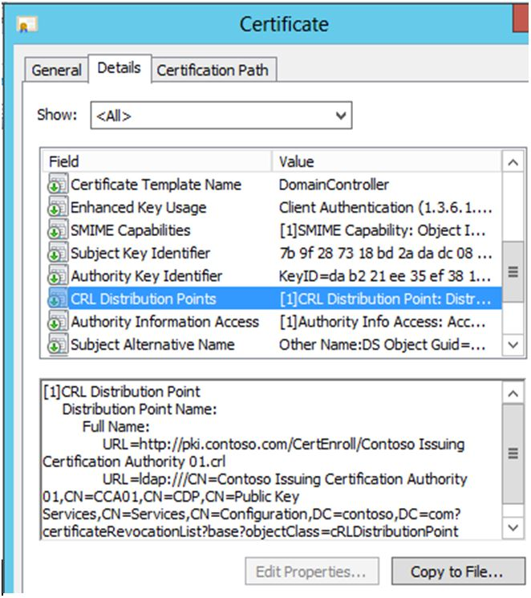
Public Key Infrastructure (PKI) – Certificate Revocation List (CRL)
Identifies certificates that have been revoked due to fraud, theft, change in name or relationship with the CA
Expired certificates are not on the CRL
Maintained and updated periodically
Does not provide up-to-the-moment status
Many browsers fail to check CRL
Notes:
certificate revocation list (CRL) The list of certificates that have been revoked by a certificate authority before the lifetimes of the certificates have expired. Sybex 8th ed.
CRL can be distributed or stored locally.
Users should verify another’s identity through a CA by checking the CRL to make sure it is valid.
Sources:
(ISC)2 CBK 2008 (pgs. 269-270)
Shon Harris CISSP All-in-One Exam Guide 4th Edition (pgs. 725-733)

Slide 62
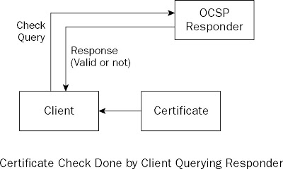
Public Key Infrastructure (PKI) – Online Certificate Status Protocol (OCSP)
Used to query the CA as to the status of a certificate issued by that CA
Particularly useful in large, complex environments
Responds to a query with a status of valid, suspended, or revoked
Notes:
In the browser
Checks with CA in real time although information maintained by CA may not reflect real time
Online Certificate Status Protocol (OCSP) A real-time facility for verifying the validity
of a digital certificate and confirming that it has not been revoked by the issuing certificate
authority. Sybex 8th ed.
Sources:
(ISC)2 CBK 2008 (pgs. 269-270)
Shon Harris CISSP All-in-One Exam Guide 4th Edition (pgs. 725-733)

Slide 63
Public Key Infrastructure (PKI) – Suspensions & Renewals
Suspensions
Certificates can be suspended (put on hold)
Suspend rather than expire certificates to make them temporarily invalid
Renewals
Unexpired certificates can be renewed close to the end of the expiring certificate's lifetime
Allows the same certificate to be used past the original expiration time
Bad practice (key life extended)
Notes:
Suspensions:
Suspend rather than expire certificates to make them temporarily invalid, particularly when you anticipate that the certificate holder will return to her normal course of duties.
Sources:
(ISC)2 CBK 2008 (pgs. 269-270)
Shon Harris CISSP All-in-One Exam Guide 4th Edition (pgs. 725-733)

Slide 64
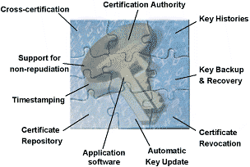
Public Key Infrastructure (PKI) – Key Management
The process of
Setting policies
Protecting keys
Key recovery
Responding to key compromise
Centralized Key Management
Decentralized Key Management
Key length: should be long enough to protect against attacks
Cryptoperiod: key lifetimes (should be shorter for more critical data)
Notes:
Key length (key space): the more valuable the data, the longer the key
Cryptoperiod: more valuable data should be protected with keys that have a shorter lifetime.
PKI (x.509) keys and certificates are found in applications, such as:
IP/SEC and other VPN protocols
Web based security protocols like SSL
Transaction layer security
E-mail security mechanisms such as PGP and SMIME
Centralized Key Management:
In charge of issuing keys (users do not have control of their keys)
Keeps a copy of the key in case they are needed
Decentralized Key Management:
End user generates the keys and submits them to the CA for validation
Does not provide for key escrow, so key recovery is not possible
Sources:
(ISC)2 CBK 2008 (pgs. 266-268)
Shon Harris CISSP All-in-One Exam Guide 4th Edition (pgs. 732-734)

Slide 65
Digital Signatures
Used to authenticate the identity of the sender of a message/document
Easily transportable
Cannot be imitated by something else
Can be automatically time stamped
Provides integrity by encrypting the hash value with the sender’s private key (message digest)
Financial transactions
E-Commerce
E-Mails
Notes:
digital signature A method for assuring a recipient that a message truly came from the
claimed sender and that the message was not altered while in transit between the sender and
recipient. Sybex 8th ed.
Based upon asymmetric (public key) algorithms
Doesn’t provide key exchange or message encryption
Authentication: In many parts of the world, digital signatures have been recognized by the government and courts as a verifiable form of authentication.
zero-knowledge proof A concept of communication whereby a specific type of information is exchanged but no real data is exchanged. Good examples of this idea are digital signatures and digital certificates. Sybex 8th ed.
Sources:
(ISC)2 CBK 2008 (pgs. 265-266)
Shon Harris CISSP All-in-One Exam Guide 4th Edition (pgs. 722-725)

Slide 66
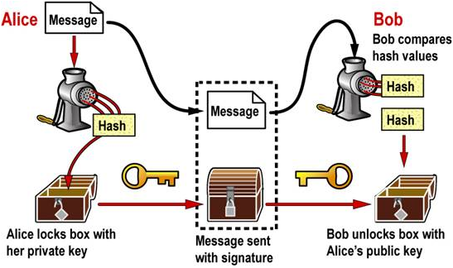
Digital Signing
Notes:
The Sender:
Creates an email message
Special software (MD5/SHA-1) creates a message hash
Uses the sender’s private key to encrypt the hash
The encrypted hash becomes the digital signature of the message and is sent along with the message to the recipient.
The Recipient:
Recipient receives the message
Recipient makes a hash of the received message to check integrity
Recipient then uses the sender’s public key to decrypt the message hash (authentication)
If after comparing the two hashes and the hashes match, the received message is valid and the sender is verified (integrity).
Sources:
(ISC)2 CBK 2008 (pgs. 265-266)
Shon Harris CISSP All-in-One Exam Guide 4th Edition (pgs. 722-725)

Slide 67
Digital Rights Management (DRM)
DRM defines the interaction between the user, permissions, and content during the creation of content, distribution and upkeep of content, and use of content
Lacks standardization
4 Types
Always on DRM
USB Key
Digital Watermark
Fingerprinting
Notes:
digital rights management A type of protection software that uses encryption to enforce
copyright restrictions on digital media. Over the past decade, publishers attempted to
deploy DRM schemes across a variety of media types including music, movies, and books. Sybex 8th ed.
Types of DRM:
Always on DRM:
Requires network connection
Very common
USB Key:
Must plug-in USB key
Digital Watermark:
Verify integrity of protected content
Fingerprinting:
Each user of a file is given a uniquely redundant part of the file that can identify the user
DMCA:
Crime to circumvent anti-piracy measures
Outlaws manufacture, sale, or distribution of code-cracking devices
Spread to other countries via WIPO treaties
Digital Millennium Copyright Act A law that establishes the prohibition of attempts to
circumvent copyright protection mechanisms placed on a protected work by the copyright
holder and limits the liability of Internet service providers when their circuits are used by
criminals violating the copyright law. Sybex 8th ed.

Slide 68
Managing Enterprise Security
For our look at enterprise FDE, we will again look at Windows BitLocker. Just remember that it’s not the only product, or even necessarily the best product for this.
It is, in my opinion, but we only use it here because it does all of the things we need to talk about and provides a good example.
If you’ve forgetting the basics of Bitlocker, refer to the previous lecture. We will be looking at enterprise implementation and management now.

Slide 69
Enterprise FDE use cases
Mobile devices – Full device encryption strongly recommended. Encrypted container secondary.
Laptops – Mandatory enrollment strongly recommended. Perfect example of FDE providing maximum benefit.
Desktops – Still a good idea, as it provides

Slide 70
Windows BitLocker
Encrypts the OS volume or secondary volumes.
Helps prevent the unauthorized disclosure of data when it is at rest
Designed to utilize a Trusted Platform Module (TPM)
Secure key storage
Boot Integrity

Slide 71


Windows 7 BitLocker What’s New
BitLocker To Go
Support for FAT*
Protectors: DRA, passphrase, smart card and/or auto-unlock
Management: protector configuration, encryption enforcement
Read-only access on Windows Vista & Windows XP

Slide 72



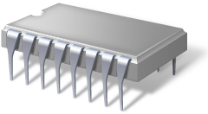

Disk Layout and Key Storage
Operating system volume contains:
Encrypted OS
Encrypted page file
Encrypted temp files
Encrypted data
Encrypted hibernation file
Where’s the encryption key?
SRK (Storage Root Key) contained in TPM
SRK encrypts the VMK (Volume Master Key)
VMK encrypts FVEK (Full Volume Encryption Key) – used for the actual data encryption
FVEK and VMK are encrypted on the OS Volume
FVEK
VMK
SRK
Operating System Volume
System
System volume contains:
MBR
Boot Manager
Boot Utilities

Slide 73
Windows BitLocker Volume
Virtual Boot Sector
Boot Sector
Virtual Boot Sector
Pointers to other metadata copies
Encrypted Volume Data
Pointer to Primary Metadata Copy
BitLocker Metadata Copies

Slide 74
Hardware Requirements
Trusted Platform Module
Trusted Platform Module (TPM) v1.2
Trusted Platform Module (TPM) Compatible BIOS
Disk Partitioning
Separate reserved system partition using NTFS
System partition minimum size of at least 100MB
Choosing the right partitioning is key for a successful deployment
Key Management Plan

Slide 75
Disk Partitioning examples
Windows RE
250 MB
NTFS
System Partition
100 MB
NTFS
OS - Encrypted
Remaining Disk
NTFS
System Partition/Windows RE
300 MB
NTFS
OS - Encrypted
Remaining Disk
NTFS
Note: An additional 50MB is required on the recovery partition for volume snapshots during Complete PC backups

Slide 76
Pre-Deployment Recommendations
Standardize the hardware and, if possible, OS (build & loadout)
Hardware pre-build configuration (OEM)
BIOS settings
Enable and Activate the TPM
BIOS passwords
Minimize the number of reboots for your users
Worst scenario – 4 reboots / Best scenario – 1 reboot
Number of reboots is key in a successful deployment of BitLocker

Slide 77
Group Policy Preparation
BitLocker Group Policy settings can
Turn on BitLocker backup to Active Directory
Enable advanced startup options, recovery options, etc.
Configure encryption method and strength
Enable FIPS compliance - before setting up BDE keys!
Enforce or disable specific protectors
Enforce a minimum PIN length

Slide 78
Group Policy Preparation
TPM Services Group Policy can
Turn on TPM owner authorization backup to Active Directory Domain Services
Configure the list of blocked TPM commands

Slide 79
Develop a Recovery Strategy
Define the process of recovery of a BitLocker system is needed
Anticipate the recovery scenarios
How to handle lost or forgotten Key Protectors?
Reset PIN, lost startup key
How are disk drive failures recovered?
How are TPM hardware failures treated?
Recover from core files or pre-OS file (BIOS upgrade, etc…) updates which are not planned
Recovering and diagnosing a deliberate attack

Slide 80
Active Directory Based Recovery
By default, no recovery information is backed up to AD
Administrators can configure GP to enable backup of BitLocker or TPM owner authorization recovery info
Schema needs to be extended
Windows Server 2008+ is “BitLocker Ready”
All domain controllers in the domain must be at least Windows Server 2003 SP1

Slide 81
Active Directory Based Recovery
Recovery data saved for each computer object
Recovery passwords - a 48-digit recovery password
Key package data (optional) - helps recovery if the disk is severely damaged
There is only one TPM owner password per computer
There can be more than one recovery password per computer
O/S Volume
Data Volumes

Slide 82
Data Recovery Agent
Certificate-based key protector
A certificate containing a public key is distributed through Group Policy and is applied to any drive that mounts
The corresponding private key is held by a data recovery agent in the IT department
Allows IT department to have a way to unlock all protected drives in an enterprise
Saves space in AD – same Key Protector on all drives

Slide 83
Windows Recovery Environment
Set of tools for troubleshooting startup problems
In Windows RE environment, user will be prompted for recovery credential on a BitLocker-enabled machine
Contains the necessary drivers and tools to unlock and repair if necessary a BDE-protected volume

Slide 84
Windows Recovery Environment
WinRE boot image needs to reside on a non-encrypted volume
BitLocker setup is now Windows RE “aware” and will move Windows RE to a proper partition if required.
Manage-BDE and Repair-BDE are now installed per default
In Windows 7
In Windows PE and in the Windows Recovery Environment (Windows RE)

Slide 85
Recommendations
Group Policies
Ensure that the group policies are configured before your deployment
Most BitLocker GPOs are not retroactive
TPM + PIN offers the best balance between security and user experience
Leverage the group policy targeting mechanism for granularity

Slide 86
Recommendations
Recovery Scenarios
WinRE should be deployed in its own partition or on the system partition
Test all your recovery scenarios
Use Active Directory if you want to build custom recovery solutions
Use Data Recovery Agents if you have a requirement for FIPS compliance

Slide 87
BitLocker Deployment
Deployment options
During build process
Post-build process
User initiated
Deployment methods
Manage-BDE
WMI
SCCM
Windows Deployment Tools

Slide 88
Deployment Options
Configuration during build process
Enabling and activating a TPM during this process will require user interaction to meet the physical presence requirement
If backup of recovery info to AD is required, BDE must be enabled after the computer has joined your AD domain
Starting encryption during the build process has performance impact, for example if there are additional tasks to be performed (install apps, etc)
Consider starting encryption at the very end of the build process

Slide 89
Deployment Options
Post-build configuration
Or triggered at a later time after the computer is delivered to the end user
Software distribution tool (SCCM)
GP scripting
Logon scripts
User initiated configuration
Allow users to selectively enroll and configure their machines for BDE
Not recommended.

Slide 90
Deployment Methods
Manage-BDE.exe command-line tool (Also, PowerShell cmdlets)
Provides configuration / administration on individual and remote machines
Location: %systemdrive%\Windows\system32
Leverages the BitLocker and TPM WMI providers
Create scripts with BitLocker and TPM WMI providers
Useful when integrating support of BitLocker machines into your help desk environment, or user initiated configuration type of deployment
Good for large enterprise deployments

Slide 91
Deployment Methods
Systems Center Configuration Manage
Unify the deployment toolsets for both client and server
Deliver an end-to-end process for deployment
Provide high degrees of flexibility to accommodate complex enterprise requirements
Use native toolsets found in Windows
Supports BitLocker natively

Slide 92
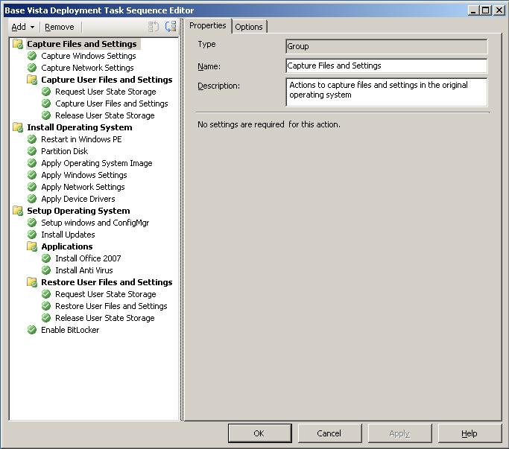

Slide 93
BitLocker Server Scenarios
BitLocker is a feature on Windows Server (optional component)
The feature needs to be installed through Server Manager
All the recommendations made in this presentation apply to the server scenario
BitLocker provides great value in branch office scenarios
Branch Office TechCenter
http://technet.microsoft.com/en-us/branchoffice/default.aspx

Slide 94
Recommendations
Bare Metal install ≠ Clean install
Make sure to partition the disk
File base imaging does not partition the disk per default
Turn on BitLocker in the post build process
Provides the most flexibility
Do not partition the disk post installation
Only Shrink the O/S volume when no other options are available
If you must shrink the disk use bdehdcfg.exe or the BitLocker Setup Wizard

Slide 95
Data Drive Specific Group Policy
BitLocker Group Policy settings can
Turn on BitLocker backup to Active Directory
Enable, enforce or disable password or smartcard protectors
Enforce a minimum password length
Enforce password complexity
Deny write access to drives not encrypted with BitLocker
Do not allow write access to devices from other organizations

Slide 96
BitLocker Enforcement
Requiring BitLocker for data drives
When this policy is enforced, all data drives will require BitLocker protection in order to have write access
As soon as a drive is plugged into a machine, a dialog is displayed to the user to either enable BitLocker on the device or only have read-only access
The user gets full RW access only after encryption is completed
Users can alternatively enable BitLocker at a later time

Slide 97
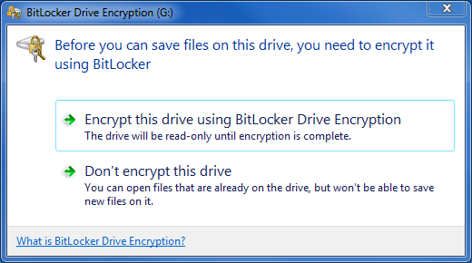
BitLocker Enforcement

Slide 98
BitLocker Cross-Organization
This policy will help enterprises manage compliance when a requirement exists to not allow devices to roam outside of the enterprise
When the "Deny write access to devices configured in another organization" policy is enabled
Only drives with identification fields matching the computer's identification fields will be given write access
When a removable data drive is accessed it will be checked for valid identification field and allowed identification fields
These fields are defined by the "Provide the unique identifiers for your organization" policy setting

Slide 99
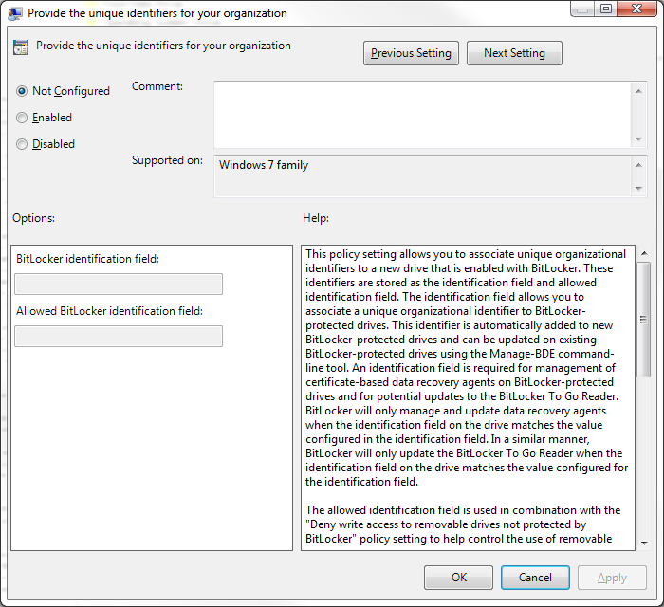

Slide 100
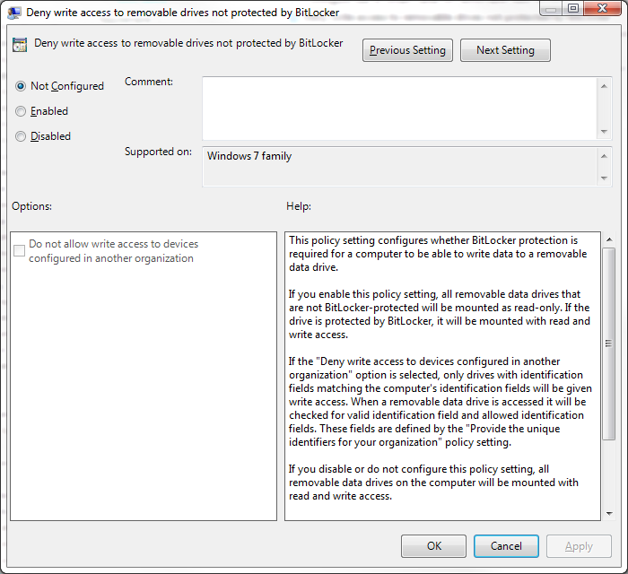

Slide 101
